Slide 1

Lecture 4
PROJECT
Time Management

Slide 2
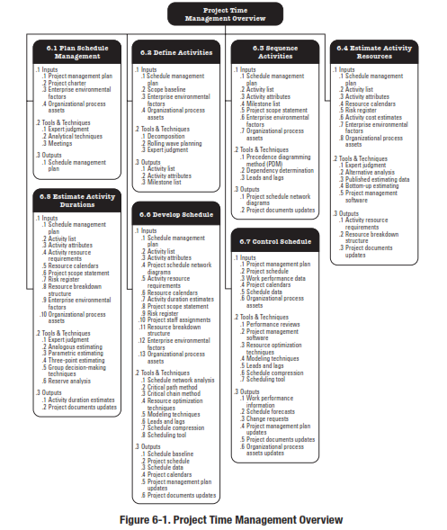
Reference: Figure 6.2.
PMBOK® Guide, 5^{h} Ed

Slide 3
PROJECT TIME MANAGEMENT
Plan Schedule Management – The process of establishing the policies, procedures, and documentation for planning, developing, managing, executing, and controlling the project schedule.
Define Activities – The process of identifying and documenting the specific actions to be performed to produce the project deliverables.
Sequence Activities – The process of identifying and documenting relationships among the project activities.
Notes:
Chapter 6
PROJECT TIME MANAGEMENT
Processes
6.1 Plan Schedule Management – The process of establishing the policies, procedures, and documentation for planning, developing, managing, executing, and controlling the project schedule.
6.2 Define Activities – The process of identifying and documenting the specific actions to be performed to produce the project deliverables.
6.3 Sequence Activities – The process of identifying and documenting relationships among the project activities.

Slide 4
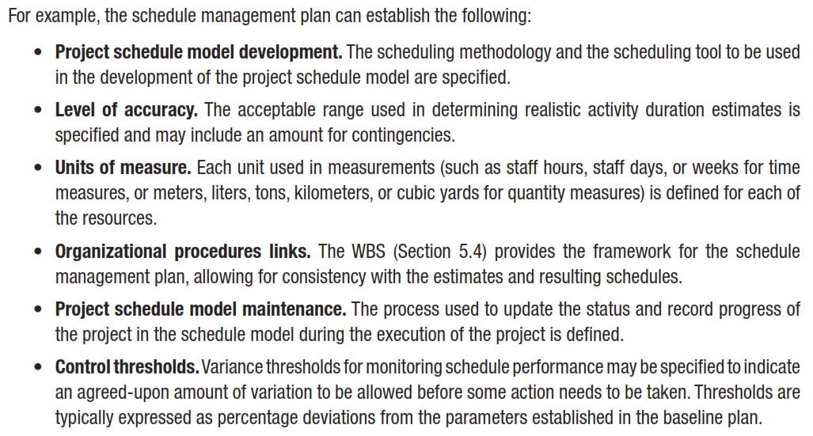
What we Have
OUTPUTS
Schedule Management Plan
Notes:
Topic 4.1.1
DEVELOP PROJECT CHARTER - INPUTS
4.1.1.1 Project Statement of Work
4.1.1.2 Business Case
4.1.1.3 Agreements
4.1.1.4 Enterprise Environmental Factors
4.1.1.4 Organizational Process Assets

Slide 5
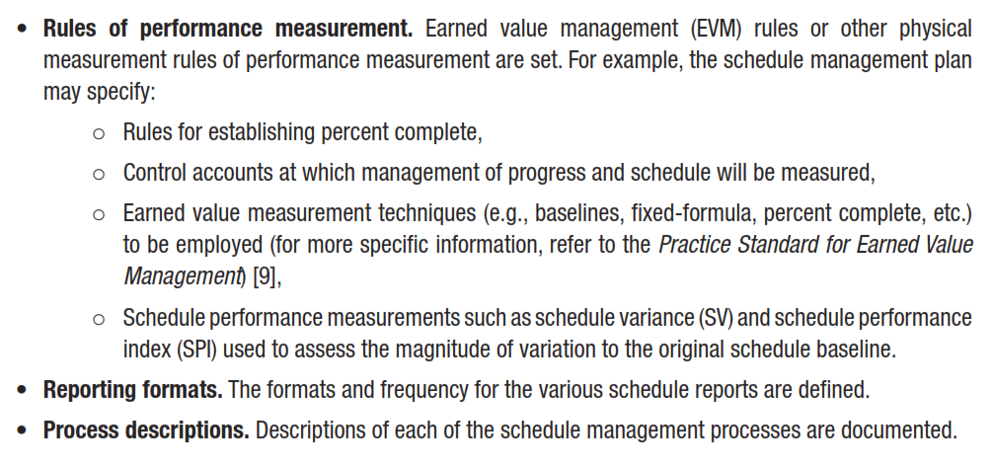
Notes:
Topic 4.1.1
DEVELOP PROJECT CHARTER - INPUTS
4.1.1.1 Project Statement of Work
4.1.1.2 Business Case
4.1.1.3 Agreements
4.1.1.4 Enterprise Environmental Factors
4.1.1.4 Organizational Process Assets

Slide 6
Activity Lists and Attributes
An activity list is a tabulation of activities to be included on a project schedule. The list should include:
  The activity name
  An activity identifier or number
  A brief description of the activity
Activity attributes provide more information about each activity, such as predecessors, successors, logical relationships, leads and lags, resource requirements, constraints, imposed dates, and assumptions related to the activity.

Slide 7
Milestones
A Milestone is a significant event that normally has no duration.
It often takes several activities and a lot of work to complete a milestone.
Milestones are useful tools for setting schedule goals and monitoring progress.
Examples include completion and customer sign-off on key documents and completion of specific products
High level milestones are given in project charter

Slide 8
Sequence Activities
  Sequence Activities is the Process of identifying and documenting relationships among the project activities.
  The key benefit of this process is that the logical sequence of work to obtain the greatest efficiency given all project constraints.
Notes:
Chapter 5
PROJECT SCOPE MANAGEMENT
SCOPE MANAGEMENT PLAN
Guidelines for how scope is to be managed and how scope changes are to be integrated into the project
It includes:
An assessment of the stability of the project scope
A clear description of how scope changes will be identified and classified

Slide 9
Sequence Activities
After defining project activities, the next step is activity sequencing
  Involves reviewing the activity list and attributes, project scope statement, milestone list and approved change requests to determine the relationships between activities
A dependency or relationship is the sequencing of project activities or tasks
You must determine dependencies in order to use critical path analysis

Slide 10
Sequence Activities
Process of identifying and documenting relationships among the project activities.
Inputs
1
Tools and Techniques
2
Outputs
3
Schedule Management Plan
Activity List
Activity Attributes
Milestone List
Project Scope Statement
Enterprise Environmental Factors
Organizational Process Assets
____________
Precedence Diagramming Method (PDM)
Dependency Determination
Leads and Lags
____________
Project Schedule Network Diagrams
Project Document Updates
____________
Notes:
Picture with three text columns
(Intermediate)
To reproduce the picture effects on this slide, do the following:
On the Home tab, in the Slides group, click Layout, and then click Blank.
On the Insert tab, in the Illustrations group, click Picture.
In the Insert Picture dialog box, select a picture and then click Insert.
Select the picture. Under Picture Tools, on the Format tab, in the bottom right corner of the Size group, click the Size and Position dialog box launcher.
In the Size and Position dialog box, on the Size tab, resize or crop the picture as needed so that under Size and rotate, the Height box is set to 1.48” and the Width box is set to 9.17”. Resize the picture under Size and rotate by entering values into the Height and Width boxes. Crop the picture under Crop from by entering values into the Left, Right, Top, and Bottom boxes.
On the Home tab, in the bottom right corner of the Drawing group, click the Format Shape dialog box launcher. In the Format Shape dialog box, click Line Color in the left pane, select Gradient line in the right pane, and then do the following:
In the Type list, select Linear.
Click the button next to Direction, and then click Linear Up (second row, second option from the left).
Under Gradient stops, click Add or Remove until two stops appear in the drop-down list.
Also under Gradient stops, customize the gradient stops that you added as follows:
Select Stop 1 from the list, and then do the following:
In the Stop position box, enter 0%.
Click the button next to Color, and then under Theme Colors click White, Background 1 (first row, first option from the left).
Select Stop 2 from the list, and then do the following:
In the Stop position box, enter 100%.
Click the button next to Color, and then under Theme Colors click White, Background 1, Darker 25% (fourth row, first option from the left).
Also in the Format Shape dialog box, click Line Style in the left pane, and then in the right pane, in the Width box, enter 1 pt.
On the Home tab, in the Drawing group, click Shape Effects, point to Glow, and then do the following:
Under Glow Variations, select any option in the first row (5 pt glow options).
Point to More Glow Colors, and then under Theme Colors click White, Background 1, Darker 25% (fourth row, first option from the left).
On the Home tab, in the Drawing group, click Arrange, point to Align, and then click Align Center.
To reproduce the first column heading on this slide, do the following:
On the Home tab, in the Drawing group, click Shapes, and then under Rectangles, click Rectangle (first option from the left). On the slide, drag to draw a rectangle.
Under Drawing Tools, on the Format tab, in the Size group, do the following:
In the Shape Height box, enter 1”.
In the Shape Width box, enter 2.92”.
On the Home tab, in the bottom right corner of the Drawing group, click the Format Shape dialog box launcher. In the Format Shape dialog box, click Fill in the left pane, select Gradient fill in the right pane, and then do the following:
In the Type list, select Linear.
Click the button next to Direction, and then click Linear Down (first row, second option from the left).
Under Gradient stops, click Add or Remove until two stops appear in the drop-down list.
Also under Gradient stops, customize the gradient stops that you added as follows:
Select Stop 1 from the list, and then do the following:
In the Stop position box, enter 32%.
Click the button next to Color, and then under Theme Colors click Tan, Background 2 (first row, third option from the left).
Select Stop 2 from the list, and then do the following:
In the Stop position box, enter 100%.
Click the button next to Color, and then under Theme Colors click Tan, Background 2, Darker 25% (third row, third option from the left).
Also in the Format Shape dialog box, click Line Color in the left pane, select Gradient line in the Line Color pane, and then do the following:
In the Type list, select Linear.
Click the button next to Direction, and then click Linear Up (second row, second option from the left).
Under Gradient stops, click Add or Remove until two stops appear in the drop-down list.
Also under Gradient stops, customize the gradient stops that you added as follows:
Select Stop 1 from the list, and then do the following:
In the Stop position box, enter 0%.
Click the button next to Color, and then under Theme Colors click White, Background 1 (first row, first option from the left).
Select Stop 2 from the list, and then do the following:
In the Stop position box, enter 100%.
Click the button next to Color, and then under Theme Colors click White, Background 1, Darker 25% (fourth row, first option from the left).
Also in the Format Shape dialog box, click Line Style in the left pane. In the right pane, in the Width box, enter 1 pt.
On the Home tab, in the Drawing group, click Shape Effects, point to Glow, and then do the following:
Under Glow Variations, select any option in the first row (5 pt glow options).
Point to More Glow Colors, and then under Theme Colors click White, Background 1, Darker 25% (fourth row, first option from the left).
On the slide, right-click the rectangle and then click Edit Text.
Enter text in the text box and select the text. On the Home tab, in the Font group, select Gill Sans MT from the Font list and then select 24 from the Font Size list.
On the Home tab, in the Paragraph group, click Align Text Left to align the text left within the text box.
Under Drawing Tools, on the Format tab, in the WordArt Styles group, click the arrow next to Text Fill, and then under Theme Colors click Tan, Background 2, Darker 75% (fifth row, third option from the left).
On the Home tab, in the bottom-right corner of the Drawing group, click the Format Shapes dialog box launcher. In the Format Shapes dialog box, click Text Box in the left pane. In the right pane, under Internal margin, enter 1” in the Left box to increase the left margin in the rectangle to accommodate the embossed number.
On the Home tab, in the Drawing group, click Shapes, and then under Lines, click Line (first option from the left).
Press and hold SHIFT, and then on the slide, drag to draw a straight, vertical line.
Under Drawing Tools, on the Format tab, in the Size group, in the Width box, enter 0.75”.
On the Home tab, in the bottom-right corner of the Drawing group, click the Format Shapes dialog box launcher. In the Format Shapes dialog box, click Line Style in the left pane, and then do the following in the right pane:
In the Width box, enter 2.25 pt.
Click the button next to Dash type, and then click Round Dot (second option from the top).
Also in the Format Shapes dialog box, click Line Color in the left pane. In the right pane, click the button next to Color, and then under Theme Colors click White, Background 1 (first row, first option from the left).
On the slide, drag the line onto the rectangle, just left of the text box.
On the Insert tab, in the Text box, click Text Box and then on the slide, drag to draw another text box.
Enter 1 in the text box and select the text. On the Home tab, in the Font group, select Calisto MT from the Font list and then enter 50 in the Font Size box.
On the Home tab, in the Paragraph group, click Center to center the text within the text box.
Under Drawing Tools, on the Format tab, in the WordArt Styles group, click the arrow next to Text Fill, and then under Theme Colors click Tan, Background 2, Darker 25% (third row, third option from the left).
Drag the text box onto the rectangle, left of the dotted vertical line.
On the Home tab, in the Editing group, click Select, and then click Selection Pane.
In the Selection and Visibility pane, press and hold CTRL to select the text box, line, and rectangle.
On the Home tab, in the Drawing group, click Arrange, point to Align, and then click Align Middle.
To reproduce the other column headings on this slide, do the following:
On the Home tab, in the Editing group, click Select, and then click Selection Pane.
In the Selection and Visibility pane, press and hold CTRL to select the text box, line, and rectangle.
On the Home tab, in the Drawing group, click Arrange, and then under Group Objects click Group.
On the Home tab, in the Clipboard group, click the arrow under Paste, and then click Duplicate. Repeat the process until you have a total of three groups of shapes.
Select each group in the Selection and Visibility pane and drag it on the slide to form a row under the picture.
Also in the Selection and Visibility pane, press and hold CTRL and select all three groups. On the Home tab, in the Drawing group, click Arrange, point to Align, and then do the following:
Click Align Middle.
Click Distribute Horizontally.
To change the numbers in the duplicate text boxes (second and third from the left), click in each text box and edit the text.
To reproduce the first column (the “subtext” portion) on this slide, do the following:
On the Home tab, in the Drawing group, click Shapes, and then under Rectangles click Rectangle (first option from the left).
On the slide, drag to draw the rectangle so that the top edge is just below the first column heading and the bottom edge is at the bottom of the slide.
Under Drawing Tools, on the Format tab, in the Size group, in the Shape Width box, enter 2.92” so that the subtext column is the same width as the column heading above it.
On the Home tab, in the Drawing group, click the arrow next to Shape Outline, and then click No Outline.
On the Home tab, in the bottom right corner of the Drawing group, click the Format Shape dialog box launcher. In the Format Shape dialog box, click Fill in the left pane, select Gradient fill in the right pane, and then do the following:
In the Type list, select Linear.
Click the button next to Direction, and then click Linear Down (first row, second option from the left).
Under Gradient stops, click Add or Remove until three stops appear in the drop-down list.
Also under Gradient stops, customize the gradient stops that you added as follows:
Select Stop 1 from the list, and then do the following:
In the Stop position box, enter 0%.
Click the button next to Color, and then under Theme Colors click White, Background 1 (first row, first option from the left).
In the Transparency box, enter 100%.
Select Stop 2 from the list, and then do the following:
In the Stop position box, enter 50%.
Click the button next to Color, and then under Theme Colors click Tan, Background 2, Darker 25% (third row, third option from the left).
In the Transparency box, enter 25%.
Select Stop 3 from the list, and then do the following:
In the Stop position box, enter 100%.
Click the button next to Color, and then under Theme Colors click White, Background 1 (first row, first option from the left).
In the Transparency box, enter 100%.
On the slide, right-click the column and then click Edit Text.
Enter text in the text box and select the text. On the Home tab, in the Font group, select Gill Sans MT from the Font list and then enter 22 in the Font Size box.
On the Home tab, in the Paragraph group, click Center to center the text within the rectangle.
Under Drawing Tools, on the Format tab, in the WordArt Styles group, click the arrow next to Text Fill, and then under Theme Colors click White, Background 1, Darker 50% (sixth row, first option from the left).
On the Home tab, in the bottom-right corner of the Drawing group, click the Format Shapes dialog box launcher. In the Format Shapes dialog box, click Text Box in the left pane. In the right pane, under Text layout, in the Vertical Alignment list, select Top.
To reproduce the other columns (the “subtext” portion) on this slide, do the following:
Select the first “subtext” rectangle. On the Home tab, in the Clipboard group, click the arrow under Paste, and then click Duplicate. Repeat the process until you have a total of three “subtext” rectangles.
Drag each duplicate on the slide to form a row under the “text heading” rectangles.
Press and hold SHIFT and select all three “subtext” rectangles. On the Home tab, in the Drawing group, click Arrange, point to Align, and then click Distribute Horizontally.
To reproduce the background on this slide, do the following:
Right-click the slide background area, and then click Format Background. In the Format Background dialog box, click Fill in the left pane, select Gradient fill in the right pane, and then do the following:
In the Type list, select Radial.
Click the button next to Direction, and then click From Center (third option from the left).
Under Gradient stops, click Add or Remove until two stops appear in the drop-down list.
Also under Gradient stops, customize the gradient stops that you added as follows:
Select Stop 1 from the list, and then do the following:
In the Stop position box, enter 0%.
Click the button next to Color, and then under Theme Colors click White, Background 1 (first row, first option from the left).
Select Stop 2 from the list, and then do the following:
In the Stop position box, enter 100%.
Click the button next to Color, and then under Theme Colors click Tan, Background 2 (first row, third option from the left).

Slide 11
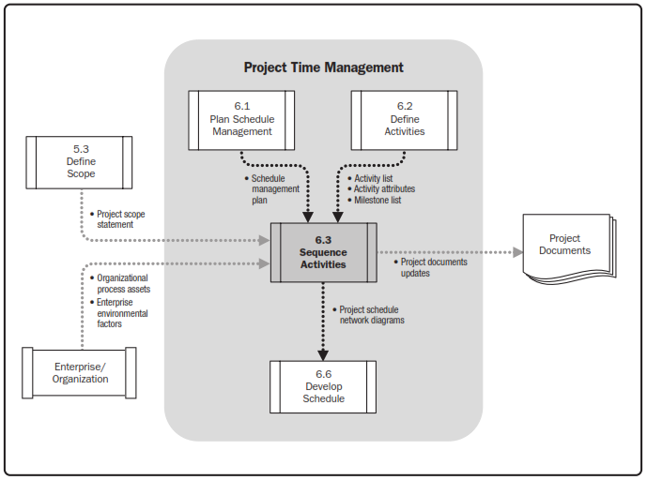
Sequence Activities

Slide 12
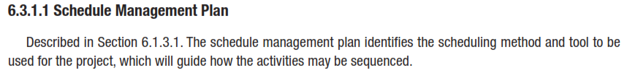
INPUTS
Notes:
Topic 4.1.1
DEVELOP PROJECT CHARTER - INPUTS
4.1.1.1 Project Statement of Work
4.1.1.2 Business Case
4.1.1.3 Agreements
4.1.1.4 Enterprise Environmental Factors
4.1.1.4 Organizational Process Assets

Slide 13
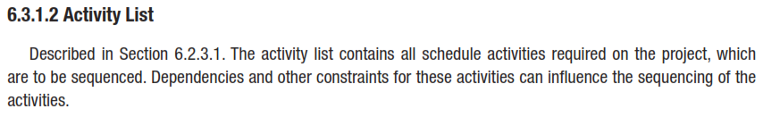
Sequence Activities
INPUTS
Notes:
Topic 4.1.1
DEVELOP PROJECT CHARTER - INPUTS
4.1.1.1 Project Statement of Work
4.1.1.2 Business Case
4.1.1.3 Agreements
4.1.1.4 Enterprise Environmental Factors
4.1.1.4 Organizational Process Assets

Slide 14
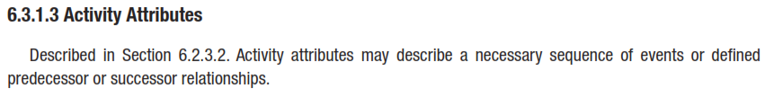
Sequence Activities
INPUTS
Notes:
Topic 4.1.1
DEVELOP PROJECT CHARTER - INPUTS
4.1.1.1 Project Statement of Work
4.1.1.2 Business Case
4.1.1.3 Agreements
4.1.1.4 Enterprise Environmental Factors
4.1.1.4 Organizational Process Assets

Slide 15
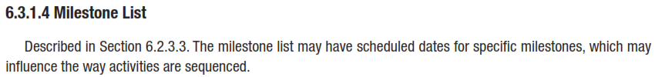
Sequence Activities
INPUTS
Notes:
Topic 4.1.1
DEVELOP PROJECT CHARTER - INPUTS
4.1.1.1 Project Statement of Work
4.1.1.2 Business Case
4.1.1.3 Agreements
4.1.1.4 Enterprise Environmental Factors
4.1.1.4 Organizational Process Assets

Slide 16
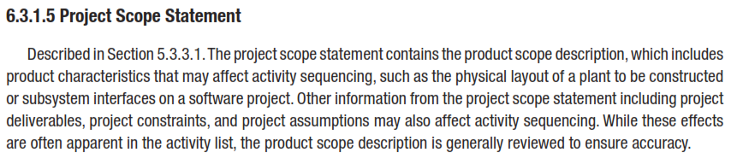
Sequence Activities
INPUTS
Notes:
Topic 4.1.1
DEVELOP PROJECT CHARTER - INPUTS
4.1.1.1 Project Statement of Work
4.1.1.2 Business Case
4.1.1.3 Agreements
4.1.1.4 Enterprise Environmental Factors
4.1.1.4 Organizational Process Assets

Slide 17
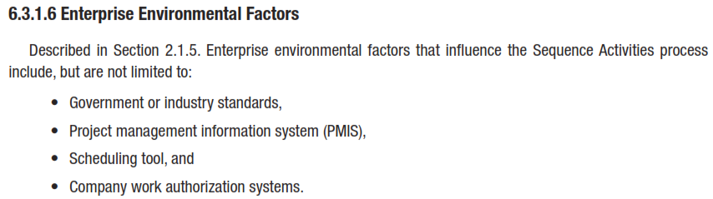
Sequence Activities
Notes:
Topic 4.1.1
DEVELOP PROJECT CHARTER - INPUTS
4.1.1.1 Project Statement of Work
4.1.1.2 Business Case
4.1.1.3 Agreements
4.1.1.4 Enterprise Environmental Factors
4.1.1.4 Organizational Process Assets

Slide 18
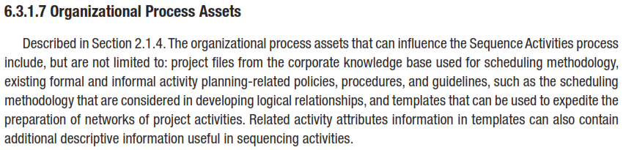
Sequence Activities
Notes:
Topic 4.1.1
DEVELOP PROJECT CHARTER - INPUTS
4.1.1.1 Project Statement of Work
4.1.1.2 Business Case
4.1.1.3 Agreements
4.1.1.4 Enterprise Environmental Factors
4.1.1.4 Organizational Process Assets

Slide 19
Sequence Activities
TOOLS & TECHNIQUES
Precedence Diagramming Method (PDM)
Dependency Determination
Leads and Lags
Notes:
Topic 4.1.1
DEVELOP PROJECT CHARTER - INPUTS
4.1.1.1 Project Statement of Work
4.1.1.2 Business Case
4.1.1.3 Agreements
4.1.1.4 Enterprise Environmental Factors
4.1.1.4 Organizational Process Assets

Slide 20
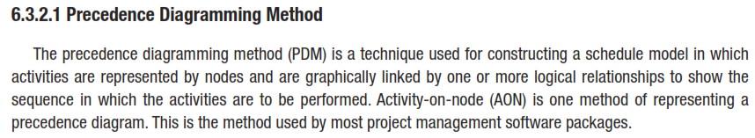
Sequence Activities
Notes:
Topic 4.1.1
DEVELOP PROJECT CHARTER - INPUTS
4.1.1.1 Project Statement of Work
4.1.1.2 Business Case
4.1.1.3 Agreements
4.1.1.4 Enterprise Environmental Factors
4.1.1.4 Organizational Process Assets

Slide 21
Precedence Diagramming Method (PDM)
Sequence Activities
More popular than ADM method and used by project management software
Activities are represented by boxes
Arrows show relationships between activities
Better at showing different types of dependencies

Slide 22
Arrow Diagramming Method (ADM)
Sequence Activities
Also called activity-on-arrow (AOA) network diagrams
Activities are represented by arrows
Nodes or circles are the starting and ending points of activities
Can only show finish-to-start dependencies
Can omit activities that have no dependencies

Slide 23
A Comparison of AON and AOA Network Conventions
Sequence Activities
Activity on Activity Activity on
Node (AON) Meaning Arrow (AOA)
B and C cannot begin until A is completed. D cannot begin until both B and C are completed. A dummy activity is again introduced in AOA.
A
B
D
A
B
D
Dummy activity
C
C

Slide 24
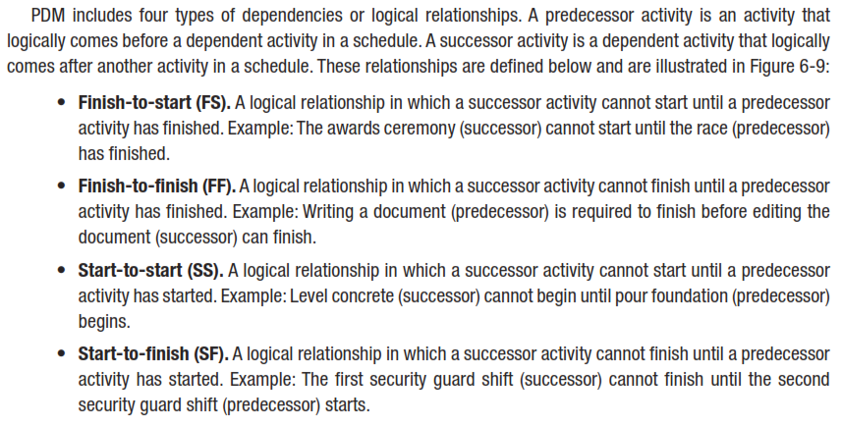
Sequence Activities
RELATIOSHIPS
Notes:
Topic 4.1.1
DEVELOP PROJECT CHARTER - INPUTS
4.1.1.1 Project Statement of Work
4.1.1.2 Business Case
4.1.1.3 Agreements
4.1.1.4 Enterprise Environmental Factors
4.1.1.4 Organizational Process Assets

Slide 25
relationships
Finish-to-Start – Activity A must finish before Activity B can start
A
B
Start-to-Start – Activity A must start before Activity B can start
A
B
Notes:
Finish-to-start – Activity A must finish before Activity B can start
Finish-to-finish – Activity A must finish before Activity B can start

Slide 26
Sequence Activities
relationships
Finish-to-Finish – Activity A must finish before Activity B can finish
A
B
Start-to-Finish – Activity A must start before Activity B can finish
A
B

Slide 27
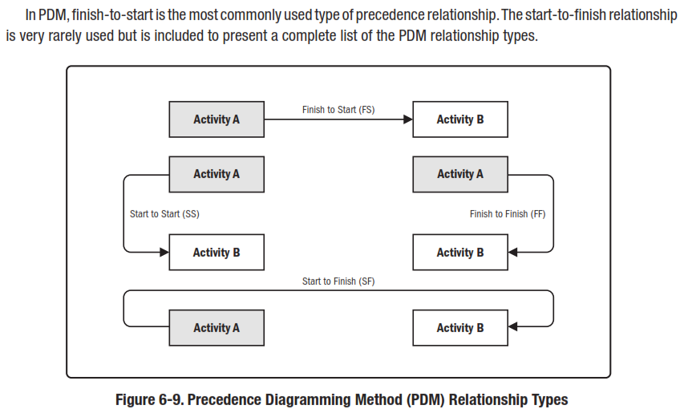
Precedence Diagramming Method (PDM)

Slide 28
AON Example
Activity | Description | Immediate Predecessors
A | Build internal components | —
B | Modify roof and floor | —
C | Construct collection stack | A
D | Pour concrete and install frame | A, B
E | Build high-temperature burner | C
F | Install pollution control system | C
G | Install air pollution device | D, E
H | Inspect and test | F, G
Table 3.1

Slide 29
Precedence Diagramming Method (PDM)
Activities are represented by boxes.
Arrows show relationships between activities.
Better at showing different types of dependencies.

Slide 30
AON Network
Sequence Activities
Activity A
(Build Internal Components)
A
Start
Activity B
(Modify Roof and Floor)
Start Activity
B

Slide 31
Sequence Activities
Activity A Precedes Activity C
A
C
Start
B
D
Activities A and B Precede Activity D

Slide 32
Sequence Activities
F
A
C
E
Start
H
B
D
G
Arrows Show Precedence Relationships

Slide 33
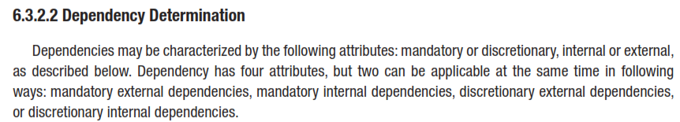
Sequence Activities
TOOLS & TECHNIQUES
Notes:
Topic 4.1.1
DEVELOP PROJECT CHARTER - INPUTS
4.1.1.1 Project Statement of Work
4.1.1.2 Business Case
4.1.1.3 Agreements
4.1.1.4 Enterprise Environmental Factors
4.1.1.4 Organizational Process Assets

Slide 34
Three Types of Dependencies
Sequence Activities
Mandatory dependencies: inherent in the nature of the work being performed on a project, sometimes referred to as hard logic
Discretionary dependencies: defined by the project team; sometimes referred to as soft logic and should be used with care since they may limit later scheduling options
  Don’t start detailed design work until users sign-off on all the analysis – good practice but can delay project
External dependencies: involve relationships between project and non-project activities
  Delivery of new hardware; if delayed can impact project schedule

Slide 35
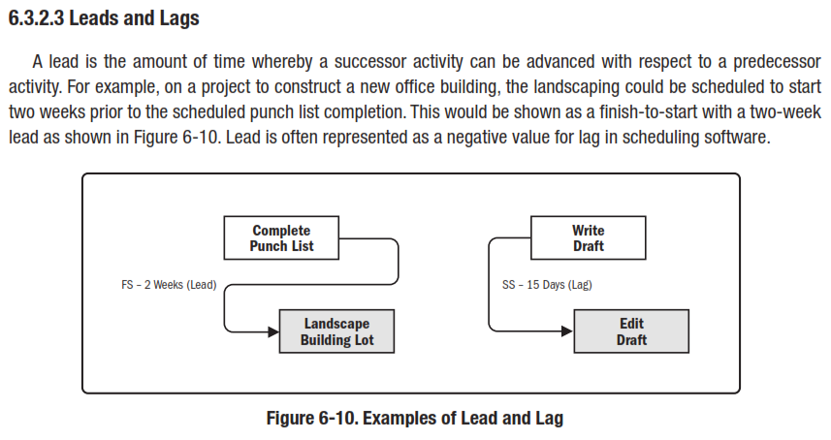
Sequence Activities
Leads and Lags
Notes:
Topic 4.1.1
DEVELOP PROJECT CHARTER - INPUTS
4.1.1.1 Project Statement of Work
4.1.1.2 Business Case
4.1.1.3 Agreements
4.1.1.4 Enterprise Environmental Factors
4.1.1.4 Organizational Process Assets

Slide 36
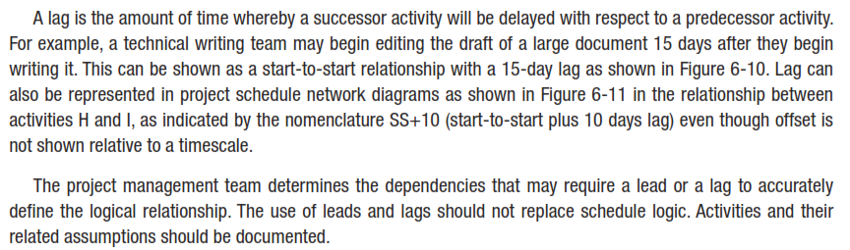
Sequence Activities
Leads and Lags
Notes:
Topic 4.1.1
DEVELOP PROJECT CHARTER - INPUTS
4.1.1.1 Project Statement of Work
4.1.1.2 Business Case
4.1.1.3 Agreements
4.1.1.4 Enterprise Environmental Factors
4.1.1.4 Organizational Process Assets

Slide 37
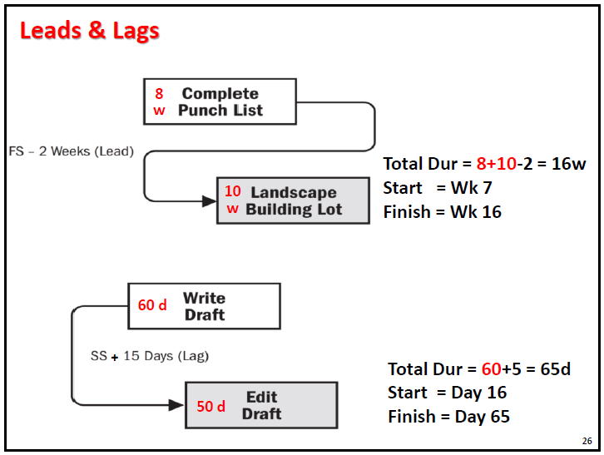

Slide 39
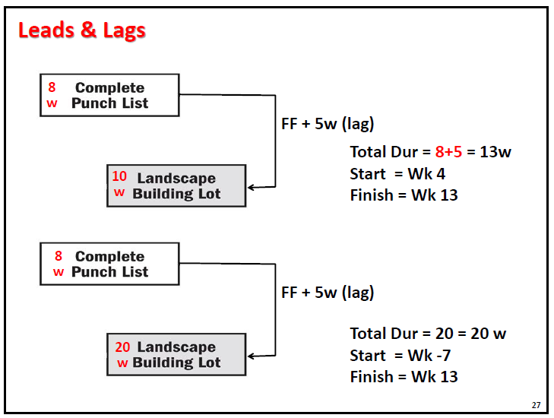

Slide 41
Sequence Activities
OUTPUTS
Project Schedule Network Diagram
Project Documents Updates
  Activity List
  Activity Attributes
  Milestone List
  Risk Register
  Enterprise Environmental Factors
Organizational Process Assets
Notes:
Topic 4.1.1
DEVELOP PROJECT CHARTER - INPUTS
4.1.1.1 Project Statement of Work
4.1.1.2 Business Case
4.1.1.3 Agreements
4.1.1.4 Enterprise Environmental Factors
4.1.1.4 Organizational Process Assets

Slide 42
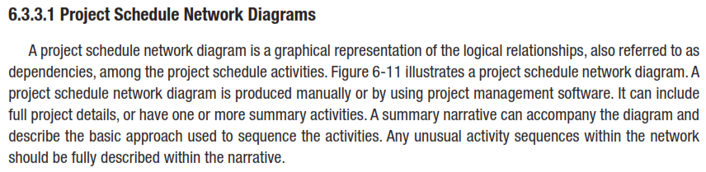
Sequence Activities
OUTPUTS
Notes:
Topic 4.1.1
DEVELOP PROJECT CHARTER - INPUTS
4.1.1.1 Project Statement of Work
4.1.1.2 Business Case
4.1.1.3 Agreements
4.1.1.4 Enterprise Environmental Factors
4.1.1.4 Organizational Process Assets

Slide 43
Network Diagrams
Sequence Activities
Network diagrams are the preferred technique for showing activity sequencing
A network diagram is a schematic display of the logical relationships among, or sequencing of, project activities
Two main formats are the arrow and precedence diagramming methods

Slide 44
Network Diagrams
Sequence Activities
Steps in Network Diagraming
Specify the individual activities.
Determine the sequence of those activities.
Draw a network diagram.
Estimate the completion time for each activity.
Identify the critical path (longest path through the network)

Slide 45
Sequence Activities
Develop Network Diagram?
Activity Description Time (weeks)
A Build internal components 2
B Modify roof and floor 3
C Construct structure 2
D Pour concrete and install frame 4
E Build high-temperature burner 4
F Install pollution control system 3
G Install air pollution device 5
H Inspect and test 2
Total Time (weeks) 25

Slide 46
Sequence Activities
Activity | Description | Immediate Predecessors
A | Build internal components | —
B | Modify roof and floor | —
C | Construct collection stack | A
D | Pour concrete and install frame | A, B
E | Build high-temperature burner | C
F | Install pollution control system | C
G | Install air pollution device | D, E
H | Inspect and test | F, G

Slide 47
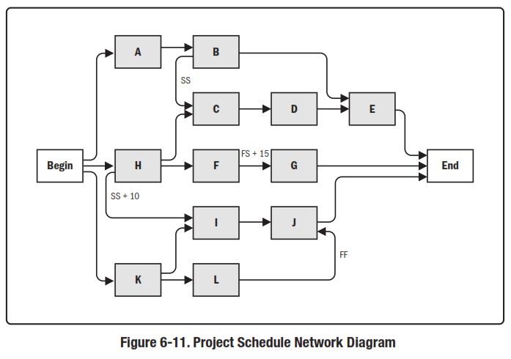
Sequence Activities
OUTPUTS
6.3.3.1 Project Schedule Network Diagram
Notes:
Topic 4.1.1
DEVELOP PROJECT CHARTER - INPUTS
4.1.1.1 Project Statement of Work
4.1.1.2 Business Case
4.1.1.3 Agreements
4.1.1.4 Enterprise Environmental Factors
4.1.1.4 Organizational Process Assets

Slide 48
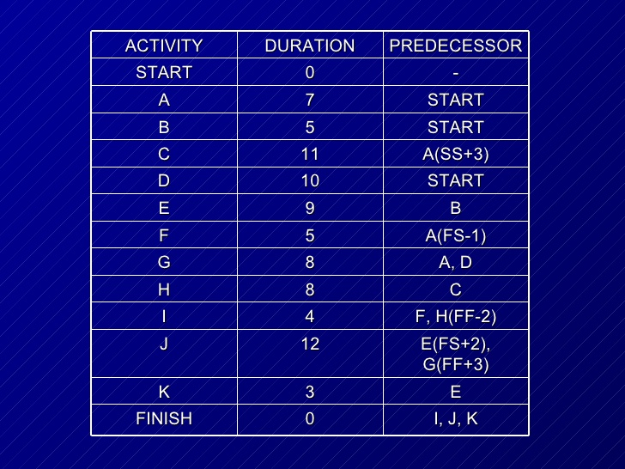
Assignment

Slide 49
Path Convergence
In an effort to consolidate efforts and eliminate redundancies, it is often the case that it makes sense to merge, combine a series or set of items.
Path convergence refers to the instance in which the project management team and or project management team leader represents the act of actually converging and merging and or joining a number of parallel schedule network paths into the same point, or node, on the pre-existing project schedule network diagram.
Path convergence involves the act of characterizing a preexisting schedule activity into with more than one single predecessor activity. Path convergence is quite common to find as a project unfolds and it can cause for confusion if not handled carefully by the project team.

Slide 50
Path Divergence
Path divergence plays a significant and important role in the life of a project and the attempts by the project management team.
instance in which the project management team and or project management team leader represents the act of actually extending or generating parallel schedule networkpaths from the same point, or node, on the pre-existing project schedule network diagram. Ultimately, when all is said and done
path divergence when conducted by the project management team and the project management team leader involves the act of characterizing a preexisting schedule activity into with more than one single successor activity. Path convergence is quite common to find as a project unfolds and it can cause for confusion if not handled carefully by the project team.

Slide 51
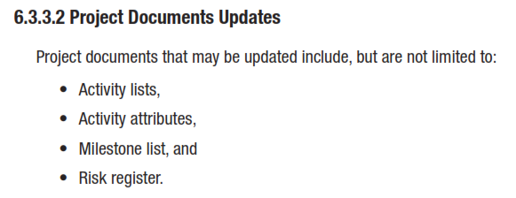
OUTPUTS
Notes:
Topic 4.1.1
DEVELOP PROJECT CHARTER - INPUTS
4.1.1.1 Project Statement of Work
4.1.1.2 Business Case
4.1.1.3 Agreements
4.1.1.4 Enterprise Environmental Factors
4.1.1.4 Organizational Process Assets

Slide 52
Estimate
ACTIVITY resources
Notes:
Chapter 4
PROJECT integration MANAGEMENT

Slide 53
Estimate Activity Resources
  Estimate Activity resources is the Process of estimating the type and quantities of material, human resources, equipment, or supplies required to perform each activity.
  The key benefit of this process is that it identifies the type, quantity, and characteristics of resources required to complete the activity which allows more accurate cost and duration estimates.
Notes:
Chapter 5
PROJECT SCOPE MANAGEMENT
SCOPE MANAGEMENT PLAN
Guidelines for how scope is to be managed and how scope changes are to be integrated into the project
It includes:
An assessment of the stability of the project scope
A clear description of how scope changes will be identified and classified

Slide 54
Estimate Activity Resources
Estimating
  The process of forecasting or approximating the time and cost of completing project deliverables.
  The task of balancing expectations of stakeholders and need for control while the project is implemented.
Types of Estimates
  Top-down (macro) estimates: analogy, group consensus, or mathematical relationships
  Bottom-up (micro) estimates: estimates of elements
  of the work breakdown structure

Slide 55
Why Estimating Time and Cost Are Important
To support good decisions.
To schedule work.
To determine how long the project should take and its cost.
To determine whether the project is worth doing.
To develop cash flow needs.
To determine how well the project is progressing.
To develop time-phased budgets and establish the project baseline.

Slide 56
Factors Influencing the Quality of Estimates
Planning Level
Other (Nonproject)
Factors
Project
Duration
Quality of Estimates
Organization
Culture
People
Padding
Estimates
Project Structure and Organization

Slide 57
Estimating Guidelines for Times,
Costs and Resources
Have people familiar with the tasks make the estimate.
Use several people to make estimates.
Use consistent units in estimating task times.
Don’t make allowances for contingencies.
Adding a risk assessment helps avoid surprises
to stakeholders.
Before estimating activity durations, you must have a good idea of the quantity and type of resources that will be assigned to each activity
Consider important issues in estimating resources
  How difficult will it be to do specific activities on this project?
  What is the organization’s history in doing similar activities?
  Are the required resources available or need to be acquired?

Slide 58
Top-Down versus Bottom-Up Estimating
Top-Down Estimates
  Are usually are derived from someone who uses experience and/or information to determine the project duration and total cost.
  Are made by top managers who have little knowledge of the processes used to complete the project.
Bottom-Up Approach
  Can serve as a check on cost elements in the WBS
  by rolling up the work packages and associated cost accounts to major deliverables at the work package level.

Slide 59
Estimate Activity Resources
Inputs
Tools and Techniques
Outputs
Schedule Management Plan
Activity List
Activity Attributes
Resource Calendars
Risk register
Activity Cost estimates
Enterprise Environmental Factors
Organizational Process Assets
1
Expert Judgment
Alternatives Analysis
Published Estimating Data
Bottom-up Estimating
Project Management Software
____________
2
Activity Resource Requirements
Resource Breakdown Structure
Project Document Updates
____________
3
Notes:
Picture with three text columns
(Inter
To reproduce the picture effects on this slide, do the following:
On the Home tab, in the Slides group, click Layout, and then click Blank.
On the Insert tab, in the Illustrations group, click Picture.
In the Insert Picture dialog box, select a picture and then click Insert.
Select the picture. Under Picture Tools, on the Format tab, in the bottom right corner of the Size group, click the Size and Position dialog box launcher.
In the Size and Position dialog box, on the Size tab, resize or crop the picture as needed so that under Size and rotate, the Height box is set to 1.48” and the Width box is set to 9.17”. Resize the picture under Size and rotate by entering values into the Height and Width boxes. Crop the picture under Crop from by entering values into the Left, Right, Top, and Bottom boxes.
On the Home tab, in the bottom right corner of the Drawing group, click the Format Shape dialog box launcher. In the Format Shape dialog box, click Line Color in the left pane, select Gradient line in the right pane, and then do the following:
In the Type list, select Linear.
Click the button next to Direction, and then click Linear Up (second row, second option from the left).
Under Gradient stops, click Add or Remove until two stops appear in the drop-down list.
Also under Gradient stops, customize the gradient stops that you added as follows:
Select Stop 1 from the list, and then do the following:
In the Stop position box, enter 0%.
Click the button next to Color, and then under Theme Colors click White, Background 1 (first row, first option from the left).
Select Stop 2 from the list, and then do the following:
In the Stop position box, enter 100%.
Click the button next to Color, and then under Theme Colors click White, Background 1, Darker 25% (fourth row, first option from the left).
Also in the Format Shape dialog box, click Line Style in the left pane, and then in the right pane, in the Width box, enter 1 pt.
On the Home tab, in the Drawing group, click Shape Effects, point to Glow, and then do the following:
Under Glow Variations, select any option in the first row (5 pt glow options).
Point to More Glow Colors, and then under Theme Colors click White, Background 1, Darker 25% (fourth row, first option from the left).
On the Home tab, in the Drawing group, click Arrange, point to Align, and then click Align Center.
To reproduce the first column heading on this slide, do the following:
On the Home tab, in the Drawing group, click Shapes, and then under Rectangles, click Rectangle (first option from the left). On the slide, drag to draw a rectangle.
Under Drawing Tools, on the Format tab, in the Size group, do the following:
In the Shape Height box, enter 1”.
In the Shape Width box, enter 2.92”.
On the Home tab, in the bottom right corner of the Drawing group, click the Format Shape dialog box launcher. In the Format Shape dialog box, click Fill in the left pane, select Gradient fill in the right pane, and then do the following:
In the Type list, select Linear.
Click the button next to Direction, and then click Linear Down (first row, second option from the left).
Under Gradient stops, click Add or Remove until two stops appear in the drop-down list.
Also under Gradient stops, customize the gradient stops that you added as follows:
Select Stop 1 from the list, and then do the following:
In the Stop position box, enter 32%.
Click the button next to Color, and then under Theme Colors click Tan, Background 2 (first row, third option from the left).
Select Stop 2 from the list, and then do the following:
In the Stop position box, enter 100%.
Click the button next to Color, and then under Theme Colors click Tan, Background 2, Darker 25% (third row, third option from the left).
Also in the Format Shape dialog box, click Line Color in the left pane, select Gradient line in the Line Color pane, and then do the following:
In the Type list, select Linear.
Click the button next to Direction, and then click Linear Up (second row, second option from the left).
Under Gradient stops, click Add or Remove until two stops appear in the drop-down list.
Also under Gradient stops, customize the gradient stops that you added as follows:
Select Stop 1 from the list, and then do the following:
In the Stop position box, enter 0%.
Click the button next to Color, and then under Theme Colors click White, Background 1 (first row, first option from the left).
Select Stop 2 from the list, and then do the following:
In the Stop position box, enter 100%.
Click the button next to Color, and then under Theme Colors click White, Background 1, Darker 25% (fourth row, first option from the left).
Also in the Format Shape dialog box, click Line Style in the left pane. In the right pane, in the Width box, enter 1 pt.
On the Home tab, in the Drawing group, click Shape Effects, point to Glow, and then do the following:
Under Glow Variations, select any option in the first row (5 pt glow options).
Point to More Glow Colors, and then under Theme Colors click White, Background 1, Darker 25% (fourth row, first option from the left).
On the slide, right-click the rectangle and then click Edit Text.
Enter text in the text box and select the text. On the Home tab, in the Font group, select Gill Sans MT from the Font list and then select 24 from the Font Size list.
On the Home tab, in the Paragraph group, click Align Text Left to align the text left within the text box.
Under Drawing Tools, on the Format tab, in the WordArt Styles group, click the arrow next to Text Fill, and then under Theme Colors click Tan, Background 2, Darker 75% (fifth row, third option from the left).
On the Home tab, in the bottom-right corner of the Drawing group, click the Format Shapes dialog box launcher. In the Format Shapes dialog box, click Text Box in the left pane. In the right pane, under Internal margin, enter 1” in the Left box to increase the left margin in the rectangle to accommodate the embossed number.
On the Home tab, in the Drawing group, click Shapes, and then under Lines, click Line (first option from the left).
Press and hold SHIFT, and then on the slide, drag to draw a straight, vertical line.
Under Drawing Tools, on the Format tab, in the Size group, in the Width box, enter 0.75”.
On the Home tab, in the bottom-right corner of the Drawing group, click the Format Shapes dialog box launcher. In the Format Shapes dialog box, click Line Style in the left pane, and then do the following in the right pane:
In the Width box, enter 2.25 pt.
Click the button next to Dash type, and then click Round Dot (second option from the top).
Also in the Format Shapes dialog box, click Line Color in the left pane. In the right pane, click the button next to Color, and then under Theme Colors click White, Background 1 (first row, first option from the left).
On the slide, drag the line onto the rectangle, just left of the text box.
On the Insert tab, in the Text box, click Text Box and then on the slide, drag to draw another text box.
Enter 1 in the text box and select the text. On the Home tab, in the Font group, select Calisto MT from the Font list and then enter 50 in the Font Size box.
On the Home tab, in the Paragraph group, click Center to center the text within the text box.
Under Drawing Tools, on the Format tab, in the WordArt Styles group, click the arrow next to Text Fill, and then under Theme Colors click Tan, Background 2, Darker 25% (third row, third option from the left).
Drag the text box onto the rectangle, left of the dotted vertical line.
On the Home tab, in the Editing group, click Select, and then click Selection Pane.
In the Selection and Visibility pane, press and hold CTRL to select the text box, line, and rectangle.
On the Home tab, in the Drawing group, click Arrange, point to Align, and then click Align Middle.
To reproduce the other column headings on this slide, do the following:
On the Home tab, in the Editing group, click Select, and then click Selection Pane.
In the Selection and Visibility pane, press and hold CTRL to select the text box, line, and rectangle.
On the Home tab, in the Drawing group, click Arrange, and then under Group Objects click Group.
On the Home tab, in the Clipboard group, click the arrow under Paste, and then click Duplicate. Repeat the process until you have a total of three groups of shapes.
Select each group in the Selection and Visibility pane and drag it on the slide to form a row under the picture.
Also in the Selection and Visibility pane, press and hold CTRL and select all three groups. On the Home tab, in the Drawing group, click Arrange, point to Align, and then do the following:
Click Align Middle.
Click Distribute Horizontally.
To change the numbers in the duplicate text boxes (second and third from the left), click in each text box and edit the text.
To reproduce the first column (the “subtext” portion) on this slide, do the following:
On the Home tab, in the Drawing group, click Shapes, and then under Rectangles click Rectangle (first option from the left).
On the slide, drag to draw the rectangle so that the top edge is just below the first column heading and the bottom edge is at the bottom of the slide.
Under Drawing Tools, on the Format tab, in the Size group, in the Shape Width box, enter 2.92” so that the subtext column is the same width as the column heading above it.
On the Home tab, in the Drawing group, click the arrow next to Shape Outline, and then click No Outline.
On the Home tab, in the bottom right corner of the Drawing group, click the Format Shape dialog box launcher. In the Format Shape dialog box, click Fill in the left pane, select Gradient fill in the right pane, and then do the following:
In the Type list, select Linear.
Click the button next to Direction, and then click Linear Down (first row, second option from the left).
Under Gradient stops, click Add or Remove until three stops appear in the drop-down list.
Also under Gradient stops, customize the gradient stops that you added as follows:
Select Stop 1 from the list, and then do the following:
In the Stop position box, enter 0%.
Click the button next to Color, and then under Theme Colors click White, Background 1 (first row, first option from the left).
In the Transparency box, enter 100%.
Select Stop 2 from the list, and then do the following:
In the Stop position box, enter 50%.
Click the button next to Color, and then under Theme Colors click Tan, Background 2, Darker 25% (third row, third option from the left).
In the Transparency box, enter 25%.
Select Stop 3 from the list, and then do the following:
In the Stop position box, enter 100%.
Click the button next to Color, and then under Theme Colors click White, Background 1 (first row, first option from the left).
In the Transparency box, enter 100%.
On the slide, right-click the column and then click Edit Text.
Enter text in the text box and select the text. On the Home tab, in the Font group, select Gill Sans MT from the Font list and then enter 22 in the Font Size box.
On the Home tab, in the Paragraph group, click Center to center the text within the rectangle.
Under Drawing Tools, on the Format tab, in the WordArt Styles group, click the arrow next to Text Fill, and then under Theme Colors click White, Background 1, Darker 50% (sixth row, first option from the left).
On the Home tab, in the bottom-right corner of the Drawing group, click the Format Shapes dialog box launcher. In the Format Shapes dialog box, click Text Box in the left pane. In the right pane, under Text layout, in the Vertical Alignment list, select Top.
To reproduce the other columns (the “subtext” portion) on this slide, do the following:
Select the first “subtext” rectangle. On the Home tab, in the Clipboard group, click the arrow under Paste, and then click Duplicate. Repeat the process until you have a total of three “subtext” rectangles.
Drag each duplicate on the slide to form a row under the “text heading” rectangles.
Press and hold SHIFT and select all three “subtext” rectangles. On the Home tab, in the Drawing group, click Arrange, point to Align, and then click Distribute Horizontally.
To reproduce the background on this slide, do the following:
Right-click the slide background area, and then click Format Background. In the Format Background dialog box, click Fill in the left pane, select Gradient fill in the right pane, and then do the following:
In the Type list, select Radial.
Click the button next to Direction, and then click From Center (third option from the left).
Under Gradient stops, click Add or Remove until two stops appear in the drop-down list.
Also under Gradient stops, customize the gradient stops that you added as follows:
Select Stop 1 from the list, and then do the following:
In the Stop position box, enter 0%.
Click the button next to Color, and then under Theme Colors click White, Background 1 (first row, first option from the left).
Select Stop 2 from the list, and then do the following:
In the Stop position box, enter 100%.
Click the button next to Color, and then under Theme Colors click Tan, Background 2 (first row, third option from the left).

Slide 60
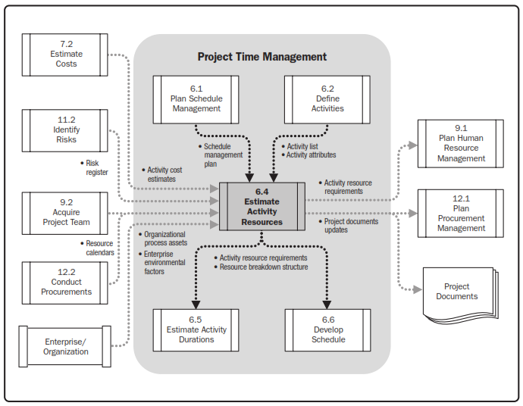
Estimate Activity Resources

Slide 61
Estimate Activity Resources
INPUTS
Schedule Management Plan
Activity List
Activity Attributes
Resource Calendars
Risk Register
Activity Cost Estimates
Enterprise Environmental Factors
Organizational Process Assets
Notes:
Topic 4.1.1
DEVELOP PROJECT CHARTER - INPUTS
4.1.1.1 Project Statement of Work
4.1.1.2 Business Case
4.1.1.3 Agreements
4.1.1.4 Enterprise Environmental Factors
4.1.1.4 Organizational Process Assets

Slide 62
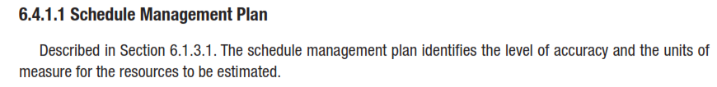
Estimate Activity Resources
INPUTS
Notes:
Topic 4.1.1
DEVELOP PROJECT CHARTER - INPUTS
4.1.1.1 Project Statement of Work
4.1.1.2 Business Case
4.1.1.3 Agreements
4.1.1.4 Enterprise Environmental Factors
4.1.1.4 Organizational Process Assets

Slide 63

Estimate Activity Resources
INPUTS
Notes:
Topic 4.1.1
DEVELOP PROJECT CHARTER - INPUTS
4.1.1.1 Project Statement of Work
4.1.1.2 Business Case
4.1.1.3 Agreements
4.1.1.4 Enterprise Environmental Factors
4.1.1.4 Organizational Process Assets

Slide 64
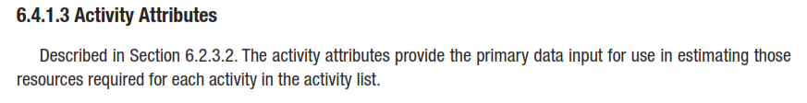
Estimate Activity Resources
INPUTS
Notes:
Topic 4.1.1
DEVELOP PROJECT CHARTER - INPUTS
4.1.1.1 Project Statement of Work
4.1.1.2 Business Case
4.1.1.3 Agreements
4.1.1.4 Enterprise Environmental Factors
4.1.1.4 Organizational Process Assets

Slide 65
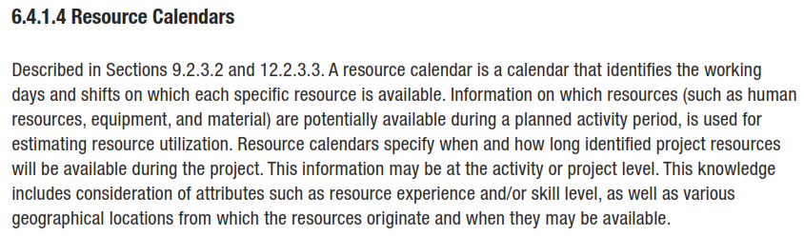
Estimate Activity Resources
INPUTS

Slide 66
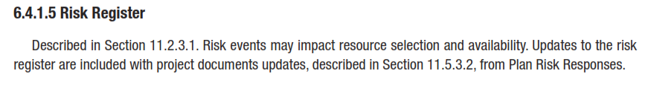
Estimate Activity Resources
INPUTS
Notes:
Topic 4.1.1
DEVELOP PROJECT CHARTER - INPUTS
4.1.1.1 Project Statement of Work
4.1.1.2 Business Case
4.1.1.3 Agreements
4.1.1.4 Enterprise Environmental Factors
4.1.1.4 Organizational Process Assets

Slide 67
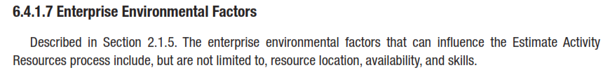
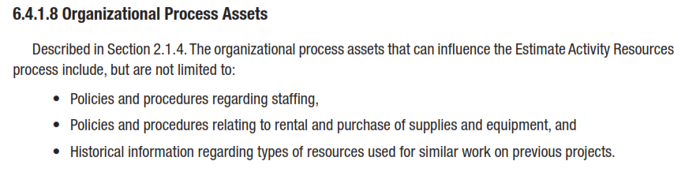
Estimate Activity Resources
INPUTS
Notes:
Topic 4.1.1
DEVELOP PROJECT CHARTER - INPUTS
4.1.1.1 Project Statement of Work
4.1.1.2 Business Case
4.1.1.3 Agreements
4.1.1.4 Enterprise Environmental Factors
4.1.1.4 Organizational Process Assets

Slide 68
Estimate Activity Resources
TOOLS & TECHNIQUES
Expert Judgment
Alternatives Analysis
Published Estimating Data
Bottom-up Estimating
Project Management Software
Notes:
Topic 4.1.1
DEVELOP PROJECT CHARTER - INPUTS
4.1.1.1 Project Statement of Work
4.1.1.2 Business Case
4.1.1.3 Agreements
4.1.1.4 Enterprise Environmental Factors
4.1.1.4 Organizational Process Assets

Slide 69
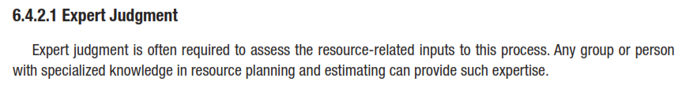
Estimate Activity Resources
TOOLS & TECHNIQUES
Notes:
Topic 4.1.1
DEVELOP PROJECT CHARTER - INPUTS
4.1.1.1 Project Statement of Work
4.1.1.2 Business Case
4.1.1.3 Agreements
4.1.1.4 Enterprise Environmental Factors
4.1.1.4 Organizational Process Assets

Slide 70
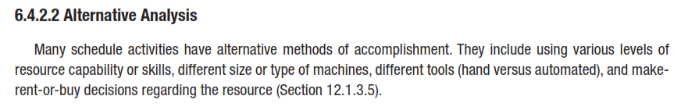
Estimate Activity Resources
TOOLS & TECHNIQUES
Notes:
Topic 4.1.1
DEVELOP PROJECT CHARTER - INPUTS
4.1.1.1 Project Statement of Work
4.1.1.2 Business Case
4.1.1.3 Agreements
4.1.1.4 Enterprise Environmental Factors
4.1.1.4 Organizational Process Assets

Slide 71
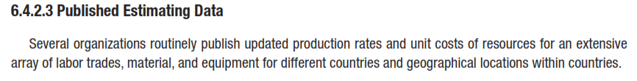
Estimate Activity Resources
TOOLS & TECHNIQUES
Notes:
Topic 4.1.1
DEVELOP PROJECT CHARTER - INPUTS
4.1.1.1 Project Statement of Work
4.1.1.2 Business Case
4.1.1.3 Agreements
4.1.1.4 Enterprise Environmental Factors
4.1.1.4 Organizational Process Assets

Slide 72
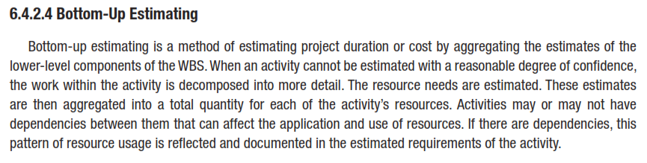
Estimate Activity Resources
TOOLS & TECHNIQUES
Notes:
Topic 4.1.1
DEVELOP PROJECT CHARTER - INPUTS
4.1.1.1 Project Statement of Work
4.1.1.2 Business Case
4.1.1.3 Agreements
4.1.1.4 Enterprise Environmental Factors
4.1.1.4 Organizational Process Assets

Slide 73
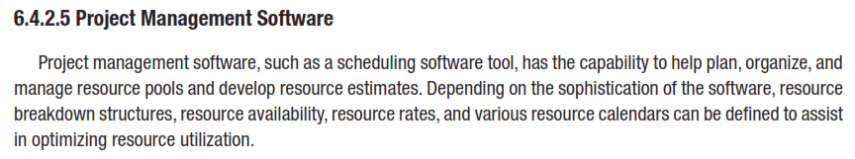
Estimate Activity Resources
TOOLS & TECHNIQUES
Notes:
Topic 4.1.1
DEVELOP PROJECT CHARTER - INPUTS
4.1.1.1 Project Statement of Work
4.1.1.2 Business Case
4.1.1.3 Agreements
4.1.1.4 Enterprise Environmental Factors
4.1.1.4 Organizational Process Assets

Slide 74
Estimate Activity Resources
OUTPUTS
Activity Resource Requirements
Resource Breakdown Structure
Project Documents Updates
Notes:
Topic 4.1.1
DEVELOP PROJECT CHARTER - INPUTS
4.1.1.1 Project Statement of Work
4.1.1.2 Business Case
4.1.1.3 Agreements
4.1.1.4 Enterprise Environmental Factors
4.1.1.4 Organizational Process Assets

Slide 75
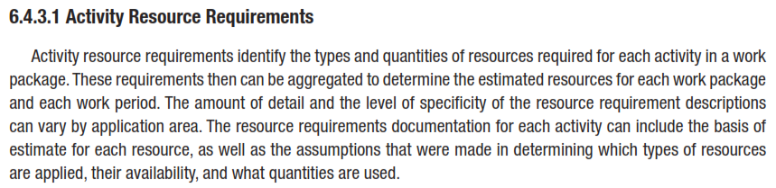
Estimate Activity Resources
OUTPUTS
Notes:
Topic 4.1.1
DEVELOP PROJECT CHARTER - INPUTS
4.1.1.1 Project Statement of Work
4.1.1.2 Business Case
4.1.1.3 Agreements
4.1.1.4 Enterprise Environmental Factors
4.1.1.4 Organizational Process Assets

Slide 76
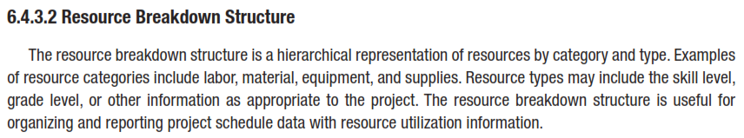
Estimate Activity Resources
OUTPUTS
Notes:
Topic 4.1.1
DEVELOP PROJECT CHARTER - INPUTS
4.1.1.1 Project Statement of Work
4.1.1.2 Business Case
4.1.1.3 Agreements
4.1.1.4 Enterprise Environmental Factors
4.1.1.4 Organizational Process Assets

Slide 77
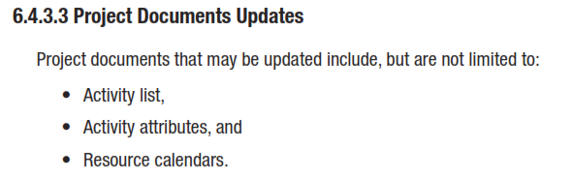
Estimate Activity Resources
OUTPUTS
Notes:
Topic 4.1.1
DEVELOP PROJECT CHARTER - INPUTS
4.1.1.1 Project Statement of Work
4.1.1.2 Business Case
4.1.1.3 Agreements
4.1.1.4 Enterprise Environmental Factors
4.1.1.4 Organizational Process Assets

Slide 78
Estimate
Activity Durations
Notes:
Chapter 4
PROJECT integration MANAGEMENT

Slide 79
Estimate Activity Durations
  Process of estimating the number of work periods needed to complete individual activities with estimated resources.
6.5
Inputs
1
Tools and Techniques
2
Outputs
3
Schedule Management Plan
Activity List
Activity Attributes
Activity Resource Requirements
Resource Calendars
Project Scope Statement
Risk Register
Resource Breakdown structure
Enterprise Environmental Factors
Organizational Process Assets
____________
Expert Judgment
Analogous Estimating
Parametric Estimating
Three-Point Estimates
Group Decision-Making Techniques
Reserve Analysis
____________
Activity Duration Estimates
Project Document Updates
____________
Notes:
Picture with three text columns
(Intermediate)
To reproduce the picture effects on this slide, do the following:
On the Home tab, in the Slides group, click Layout, and then click Blank.
On the Insert tab, in the Illustrations group, click Picture.
In the Insert Picture dialog box, select a picture and then click Insert.
Select the picture. Under Picture Tools, on the Format tab, in the bottom right corner of the Size group, click the Size and Position dialog box launcher.
In the Size and Position dialog box, on the Size tab, resize or crop the picture as needed so that under Size and rotate, the Height box is set to 1.48” and the Width box is set to 9.17”. Resize the picture under Size and rotate by entering values into the Height and Width boxes. Crop the picture under Crop from by entering values into the Left, Right, Top, and Bottom boxes.
On the Home tab, in the bottom right corner of the Drawing group, click the Format Shape dialog box launcher. In the Format Shape dialog box, click Line Color in the left pane, select Gradient line in the right pane, and then do the following:
In the Type list, select Linear.
Click the button next to Direction, and then click Linear Up (second row, second option from the left).
Under Gradient stops, click Add or Remove until two stops appear in the drop-down list.
Also under Gradient stops, customize the gradient stops that you added as follows:
Select Stop 1 from the list, and then do the following:
In the Stop position box, enter 0%.
Click the button next to Color, and then under Theme Colors click White, Background 1 (first row, first option from the left).
Select Stop 2 from the list, and then do the following:
In the Stop position box, enter 100%.
Click the button next to Color, and then under Theme Colors click White, Background 1, Darker 25% (fourth row, first option from the left).
Also in the Format Shape dialog box, click Line Style in the left pane, and then in the right pane, in the Width box, enter 1 pt.
On the Home tab, in the Drawing group, click Shape Effects, point to Glow, and then do the following:
Under Glow Variations, select any option in the first row (5 pt glow options).
Point to More Glow Colors, and then under Theme Colors click White, Background 1, Darker 25% (fourth row, first option from the left).
On the Home tab, in the Drawing group, click Arrange, point to Align, and then click Align Center.
To reproduce the first column heading on this slide, do the following:
On the Home tab, in the Drawing group, click Shapes, and then under Rectangles, click Rectangle (first option from the left). On the slide, drag to draw a rectangle.
Under Drawing Tools, on the Format tab, in the Size group, do the following:
In the Shape Height box, enter 1”.
In the Shape Width box, enter 2.92”.
On the Home tab, in the bottom right corner of the Drawing group, click the Format Shape dialog box launcher. In the Format Shape dialog box, click Fill in the left pane, select Gradient fill in the right pane, and then do the following:
In the Type list, select Linear.
Click the button next to Direction, and then click Linear Down (first row, second option from the left).
Under Gradient stops, click Add or Remove until two stops appear in the drop-down list.
Also under Gradient stops, customize the gradient stops that you added as follows:
Select Stop 1 from the list, and then do the following:
In the Stop position box, enter 32%.
Click the button next to Color, and then under Theme Colors click Tan, Background 2 (first row, third option from the left).
Select Stop 2 from the list, and then do the following:
In the Stop position box, enter 100%.
Click the button next to Color, and then under Theme Colors click Tan, Background 2, Darker 25% (third row, third option from the left).
Also in the Format Shape dialog box, click Line Color in the left pane, select Gradient line in the Line Color pane, and then do the following:
In the Type list, select Linear.
Click the button next to Direction, and then click Linear Up (second row, second option from the left).
Under Gradient stops, click Add or Remove until two stops appear in the drop-down list.
Also under Gradient stops, customize the gradient stops that you added as follows:
Select Stop 1 from the list, and then do the following:
In the Stop position box, enter 0%.
Click the button next to Color, and then under Theme Colors click White, Background 1 (first row, first option from the left).
Select Stop 2 from the list, and then do the following:
In the Stop position box, enter 100%.
Click the button next to Color, and then under Theme Colors click White, Background 1, Darker 25% (fourth row, first option from the left).
Also in the Format Shape dialog box, click Line Style in the left pane. In the right pane, in the Width box, enter 1 pt.
On the Home tab, in the Drawing group, click Shape Effects, point to Glow, and then do the following:
Under Glow Variations, select any option in the first row (5 pt glow options).
Point to More Glow Colors, and then under Theme Colors click White, Background 1, Darker 25% (fourth row, first option from the left).
On the slide, right-click the rectangle and then click Edit Text.
Enter text in the text box and select the text. On the Home tab, in the Font group, select Gill Sans MT from the Font list and then select 24 from the Font Size list.
On the Home tab, in the Paragraph group, click Align Text Left to align the text left within the text box.
Under Drawing Tools, on the Format tab, in the WordArt Styles group, click the arrow next to Text Fill, and then under Theme Colors click Tan, Background 2, Darker 75% (fifth row, third option from the left).
On the Home tab, in the bottom-right corner of the Drawing group, click the Format Shapes dialog box launcher. In the Format Shapes dialog box, click Text Box in the left pane. In the right pane, under Internal margin, enter 1” in the Left box to increase the left margin in the rectangle to accommodate the embossed number.
On the Home tab, in the Drawing group, click Shapes, and then under Lines, click Line (first option from the left).
Press and hold SHIFT, and then on the slide, drag to draw a straight, vertical line.
Under Drawing Tools, on the Format tab, in the Size group, in the Width box, enter 0.75”.
On the Home tab, in the bottom-right corner of the Drawing group, click the Format Shapes dialog box launcher. In the Format Shapes dialog box, click Line Style in the left pane, and then do the following in the right pane:
In the Width box, enter 2.25 pt.
Click the button next to Dash type, and then click Round Dot (second option from the top).
Also in the Format Shapes dialog box, click Line Color in the left pane. In the right pane, click the button next to Color, and then under Theme Colors click White, Background 1 (first row, first option from the left).
On the slide, drag the line onto the rectangle, just left of the text box.
On the Insert tab, in the Text box, click Text Box and then on the slide, drag to draw another text box.
Enter 1 in the text box and select the text. On the Home tab, in the Font group, select Calisto MT from the Font list and then enter 50 in the Font Size box.
On the Home tab, in the Paragraph group, click Center to center the text within the text box.
Under Drawing Tools, on the Format tab, in the WordArt Styles group, click the arrow next to Text Fill, and then under Theme Colors click Tan, Background 2, Darker 25% (third row, third option from the left).
Drag the text box onto the rectangle, left of the dotted vertical line.
On the Home tab, in the Editing group, click Select, and then click Selection Pane.
In the Selection and Visibility pane, press and hold CTRL to select the text box, line, and rectangle.
On the Home tab, in the Drawing group, click Arrange, point to Align, and then click Align Middle.
To reproduce the other column headings on this slide, do the following:
On the Home tab, in the Editing group, click Select, and then click Selection Pane.
In the Selection and Visibility pane, press and hold CTRL to select the text box, line, and rectangle.
On the Home tab, in the Drawing group, click Arrange, and then under Group Objects click Group.
On the Home tab, in the Clipboard group, click the arrow under Paste, and then click Duplicate. Repeat the process until you have a total of three groups of shapes.
Select each group in the Selection and Visibility pane and drag it on the slide to form a row under the picture.
Also in the Selection and Visibility pane, press and hold CTRL and select all three groups. On the Home tab, in the Drawing group, click Arrange, point to Align, and then do the following:
Click Align Middle.
Click Distribute Horizontally.
To change the numbers in the duplicate text boxes (second and third from the left), click in each text box and edit the text.
To reproduce the first column (the “subtext” portion) on this slide, do the following:
On the Home tab, in the Drawing group, click Shapes, and then under Rectangles click Rectangle (first option from the left).
On the slide, drag to draw the rectangle so that the top edge is just below the first column heading and the bottom edge is at the bottom of the slide.
Under Drawing Tools, on the Format tab, in the Size group, in the Shape Width box, enter 2.92” so that the subtext column is the same width as the column heading above it.
On the Home tab, in the Drawing group, click the arrow next to Shape Outline, and then click No Outline.
On the Home tab, in the bottom right corner of the Drawing group, click the Format Shape dialog box launcher. In the Format Shape dialog box, click Fill in the left pane, select Gradient fill in the right pane, and then do the following:
In the Type list, select Linear.
Click the button next to Direction, and then click Linear Down (first row, second option from the left).
Under Gradient stops, click Add or Remove until three stops appear in the drop-down list.
Also under Gradient stops, customize the gradient stops that you added as follows:
Select Stop 1 from the list, and then do the following:
In the Stop position box, enter 0%.
Click the button next to Color, and then under Theme Colors click White, Background 1 (first row, first option from the left).
In the Transparency box, enter 100%.
Select Stop 2 from the list, and then do the following:
In the Stop position box, enter 50%.
Click the button next to Color, and then under Theme Colors click Tan, Background 2, Darker 25% (third row, third option from the left).
In the Transparency box, enter 25%.
Select Stop 3 from the list, and then do the following:
In the Stop position box, enter 100%.
Click the button next to Color, and then under Theme Colors click White, Background 1 (first row, first option from the left).
In the Transparency box, enter 100%.
On the slide, right-click the column and then click Edit Text.
Enter text in the text box and select the text. On the Home tab, in the Font group, select Gill Sans MT from the Font list and then enter 22 in the Font Size box.
On the Home tab, in the Paragraph group, click Center to center the text within the rectangle.
Under Drawing Tools, on the Format tab, in the WordArt Styles group, click the arrow next to Text Fill, and then under Theme Colors click White, Background 1, Darker 50% (sixth row, first option from the left).
On the Home tab, in the bottom-right corner of the Drawing group, click the Format Shapes dialog box launcher. In the Format Shapes dialog box, click Text Box in the left pane. In the right pane, under Text layout, in the Vertical Alignment list, select Top.
To reproduce the other columns (the “subtext” portion) on this slide, do the following:
Select the first “subtext” rectangle. On the Home tab, in the Clipboard group, click the arrow under Paste, and then click Duplicate. Repeat the process until you have a total of three “subtext” rectangles.
Drag each duplicate on the slide to form a row under the “text heading” rectangles.
Press and hold SHIFT and select all three “subtext” rectangles. On the Home tab, in the Drawing group, click Arrange, point to Align, and then click Distribute Horizontally.
To reproduce the background on this slide, do the following:
Right-click the slide background area, and then click Format Background. In the Format Background dialog box, click Fill in the left pane, select Gradient fill in the right pane, and then do the following:
In the Type list, select Radial.
Click the button next to Direction, and then click From Center (third option from the left).
Under Gradient stops, click Add or Remove until two stops appear in the drop-down list.
Also under Gradient stops, customize the gradient stops that you added as follows:
Select Stop 1 from the list, and then do the following:
In the Stop position box, enter 0%.
Click the button next to Color, and then under Theme Colors click White, Background 1 (first row, first option from the left).
Select Stop 2 from the list, and then do the following:
In the Stop position box, enter 100%.
Click the button next to Color, and then under Theme Colors click Tan, Background 2 (first row, third option from the left).

Slide 80
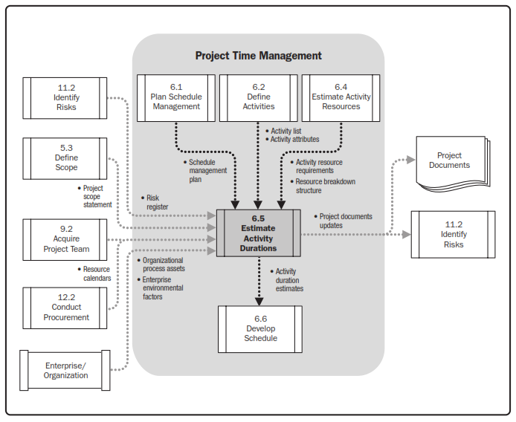
Estimate Activity Durations

Slide 81
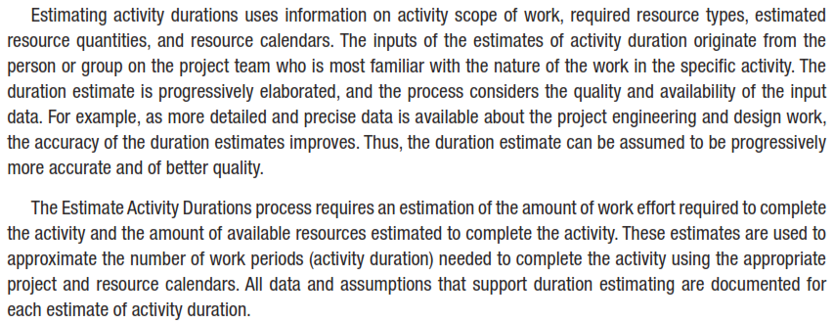
Estimate Activity Durations
Overview
Notes:
Chapter 5
PROJECT SCOPE MANAGEMENT
SCOPE MANAGEMENT PLAN
Guidelines for how scope is to be managed and how scope changes are to be integrated into the project
It includes:
An assessment of the stability of the project scope
A clear description of how scope changes will be identified and classified

Slide 82
Estimate Activity Durations
INPUTS
6.5.1.1 Schedule Management Plan
6.5.1.2 Activity List
6.5.1.3 Activity Attributes
6.5.1.4 Activity Resource Requirements
6.5.1.5 Resource Calendars
6.5.1.6 Project Scope Statement
6.5.1.7 Risk Register
6.5.1.8 Resource Breakdown Structure
6.5.1.9 Enterprise Environmental Factors
6.5.1.10 Organizational Process Assets
Notes:
Topic 4.1.1
DEVELOP PROJECT CHARTER - INPUTS
4.1.1.1 Project Statement of Work
4.1.1.2 Business Case
4.1.1.3 Agreements
4.1.1.4 Enterprise Environmental Factors
4.1.1.4 Organizational Process Assets

Slide 83
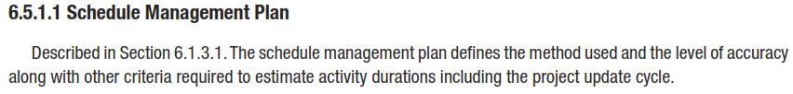
Estimate Activity Durations
INPUTS
6.5.1.1 Schedule Management Plan
Notes:
Topic 4.1.1
DEVELOP PROJECT CHARTER - INPUTS
4.1.1.1 Project Statement of Work
4.1.1.2 Business Case
4.1.1.3 Agreements
4.1.1.4 Enterprise Environmental Factors
4.1.1.4 Organizational Process Assets

Slide 84

Estimate Activity Durations
INPUTS
Activity List
Notes:
Topic 4.1.1
DEVELOP PROJECT CHARTER - INPUTS
4.1.1.1 Project Statement of Work
4.1.1.2 Business Case
4.1.1.3 Agreements
4.1.1.4 Enterprise Environmental Factors
4.1.1.4 Organizational Process Assets

Slide 85
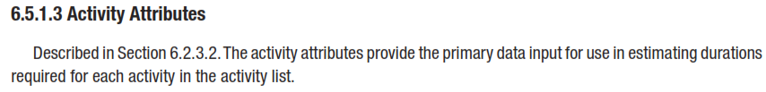
Estimate Activity Durations
INPUTS
Activity Attributes
Notes:
Topic 4.1.1
DEVELOP PROJECT CHARTER - INPUTS
4.1.1.1 Project Statement of Work
4.1.1.2 Business Case
4.1.1.3 Agreements
4.1.1.4 Enterprise Environmental Factors
4.1.1.4 Organizational Process Assets

Slide 86
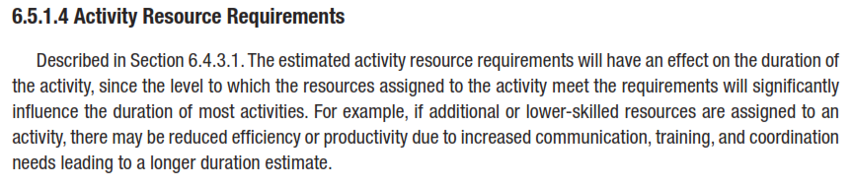
Estimate Activity Durations
INPUTS
Activity Resource Requirements
Notes:
Topic 4.1.1
DEVELOP PROJECT CHARTER - INPUTS
4.1.1.1 Project Statement of Work
4.1.1.2 Business Case
4.1.1.3 Agreements
4.1.1.4 Enterprise Environmental Factors
4.1.1.4 Organizational Process Assets

Slide 87
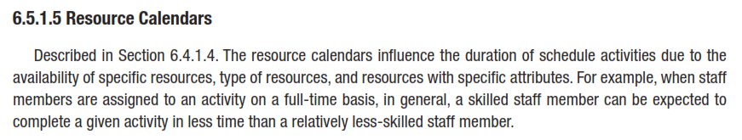
Estimate Activity Durations
INPUTS
Resource Calendars
Notes:
Topic 4.1.1
DEVELOP PROJECT CHARTER - INPUTS
4.1.1.1 Project Statement of Work
4.1.1.2 Business Case
4.1.1.3 Agreements
4.1.1.4 Enterprise Environmental Factors
4.1.1.4 Organizational Process Assets

Slide 88
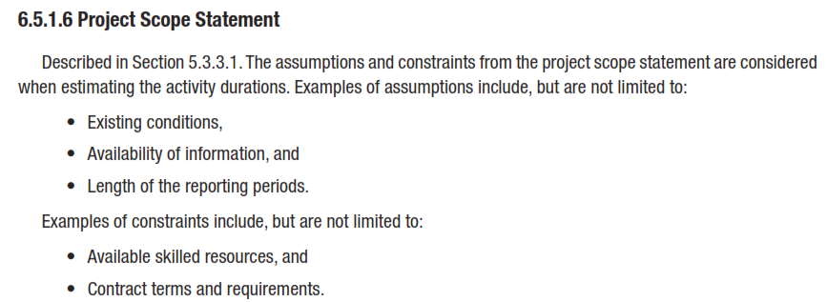
Estimate Activity Durations
INPUTS
Project Scope Statement
Notes:
Topic 4.1.1
DEVELOP PROJECT CHARTER - INPUTS
4.1.1.1 Project Statement of Work
4.1.1.2 Business Case
4.1.1.3 Agreements
4.1.1.4 Enterprise Environmental Factors
4.1.1.4 Organizational Process Assets

Slide 89
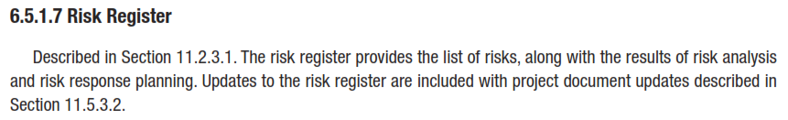
Estimate Activity Durations
INPUTS
Risk Register
Notes:
Topic 4.1.1
DEVELOP PROJECT CHARTER - INPUTS
4.1.1.1 Project Statement of Work
4.1.1.2 Business Case
4.1.1.3 Agreements
4.1.1.4 Enterprise Environmental Factors
4.1.1.4 Organizational Process Assets

Slide 90
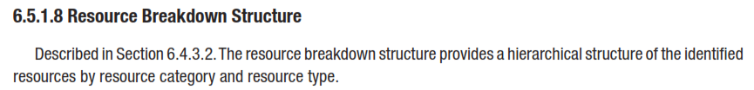
Estimate Activity Durations
INPUTS
Resource Breakdown Structure
Notes:
Topic 4.1.1
DEVELOP PROJECT CHARTER - INPUTS
4.1.1.1 Project Statement of Work
4.1.1.2 Business Case
4.1.1.3 Agreements
4.1.1.4 Enterprise Environmental Factors
4.1.1.4 Organizational Process Assets

Slide 91
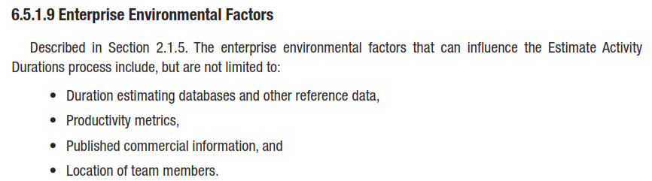
Estimate Activity Durations
INPUTS
Enterprise Environmental Factors
Notes:
Topic 4.1.1
DEVELOP PROJECT CHARTER - INPUTS
4.1.1.1 Project Statement of Work
4.1.1.2 Business Case
4.1.1.3 Agreements
4.1.1.4 Enterprise Environmental Factors
4.1.1.4 Organizational Process Assets

Slide 92
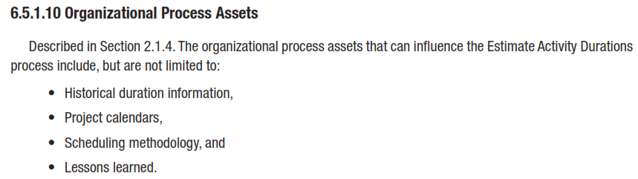
Estimate Activity Durations
INPUTS
Organizational Process Assets
Notes:
Topic 4.1.1
DEVELOP PROJECT CHARTER - INPUTS
4.1.1.1 Project Statement of Work
4.1.1.2 Business Case
4.1.1.3 Agreements
4.1.1.4 Enterprise Environmental Factors
4.1.1.4 Organizational Process Assets

Slide 93
Estimate Activity Durations
TOOLS & TECHNIQUES
Expert Judgment
Analogous Estimating
Parametric Estimating
Three-Point Estimates
Group Decision-Making Techniques
Reserve Analysis
Notes:
Topic 4.1.1
DEVELOP PROJECT CHARTER - INPUTS
4.1.1.1 Project Statement of Work
4.1.1.2 Business Case
4.1.1.3 Agreements
4.1.1.4 Enterprise Environmental Factors
4.1.1.4 Organizational Process Assets

Slide 94
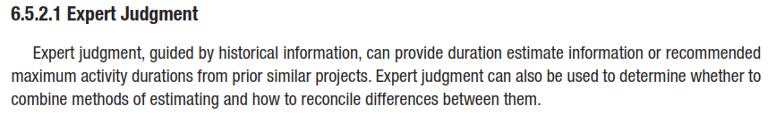
Estimate Activity Durations
Tools & Techniques
Expert Judgment
Notes:
Topic 4.1.1
DEVELOP PROJECT CHARTER - INPUTS
4.1.1.1 Project Statement of Work
4.1.1.2 Business Case
4.1.1.3 Agreements
4.1.1.4 Enterprise Environmental Factors
4.1.1.4 Organizational Process Assets

Slide 95


Estimate Activity Durations
Tools & Techniques
Analogous Estimating
Notes:
Topic 4.1.1
DEVELOP PROJECT CHARTER - INPUTS
4.1.1.1 Project Statement of Work
4.1.1.2 Business Case
4.1.1.3 Agreements
4.1.1.4 Enterprise Environmental Factors
4.1.1.4 Organizational Process Assets

Slide 96

Estimate Activity Durations
Tools & Techniques
Parametric Estimating
Notes:
Topic 4.1.1
DEVELOP PROJECT CHARTER - INPUTS
4.1.1.1 Project Statement of Work
4.1.1.2 Business Case
4.1.1.3 Agreements
4.1.1.4 Enterprise Environmental Factors
4.1.1.4 Organizational Process Assets

Slide 97


Estimate Activity Durations
Tools & Techniques
Three-Point Estimates
Notes:
Topic 4.1.1
DEVELOP PROJECT CHARTER - INPUTS
4.1.1.1 Project Statement of Work
4.1.1.2 Business Case
4.1.1.3 Agreements
4.1.1.4 Enterprise Environmental Factors
4.1.1.4 Organizational Process Assets

Slide 98



Estimate Activity Durations
Tools & Techniques
Three-Point Estimates
Most likely. The duration of the schedule activity, given the resources likely to be assigned, their productivity, realistic expectations of availability for the schedule activity, dependencies on other participants, and interruptions.
Optimistic. The activity duration is based on a best-case scenario of what is described in the most likely estimate.
Pessimistic. The activity duration is based on a worst-case scenario of what is described in the most likely estimate.

Slide 99

Estimate Activity Durations
Tools & Techniques
Three-Point Estimates

Slide 100

Estimate Activity Durations
Tools & Techniques
Group Decision-Making Techniques
Notes:
Topic 4.1.1
DEVELOP PROJECT CHARTER - INPUTS
4.1.1.1 Project Statement of Work
4.1.1.2 Business Case
4.1.1.3 Agreements
4.1.1.4 Enterprise Environmental Factors
4.1.1.4 Organizational Process Assets

Slide 101

Estimate Activity Durations
Tools & Techniques
Reserve Analysis
Notes:
Topic 4.1.1
DEVELOP PROJECT CHARTER - INPUTS
4.1.1.1 Project Statement of Work
4.1.1.2 Business Case
4.1.1.3 Agreements
4.1.1.4 Enterprise Environmental Factors
4.1.1.4 Organizational Process Assets

Slide 102
Estimate Activity Durations
OUTPUTS
Activity Duration Estimates
Project Documents Updates
Notes:
Topic 4.1.1
DEVELOP PROJECT CHARTER - INPUTS
4.1.1.1 Project Statement of Work
4.1.1.2 Business Case
4.1.1.3 Agreements
4.1.1.4 Enterprise Environmental Factors
4.1.1.4 Organizational Process Assets

Slide 103
Estimate Activity Durations
OUTPUTS
Activity Duration Estimates
Activity duration estimates are quantitative assessments of the likely number of work periods that will be required to complete a schedule activity. Activity duration estimates include some indication of the range of possible results. For example:
    2 weeks ± 2 days to indicate that the schedule activity will take at least eight days and no more than twelve (assuming a five-day workweek).
    15 percent probability of exceeding three weeks to indicate a high probability—85 percent—that the schedule activity will take three weeks or less.

Slide 104

Estimate Activity Durations
OUTPUTS
Project Documents Updates
Notes:
Topic 4.1.1
DEVELOP PROJECT CHARTER - INPUTS
4.1.1.1 Project Statement of Work
4.1.1.2 Business Case
4.1.1.3 Agreements
4.1.1.4 Enterprise Environmental Factors
4.1.1.4 Organizational Process Assets

